Slide 1



Business Insights 360 updated
View in Power BI
Last data refresh:
3/16/2025 2:37:15 PM UTC
Downloaded at:
3/16/2025 6:56:14 PM UTC

Slide 2
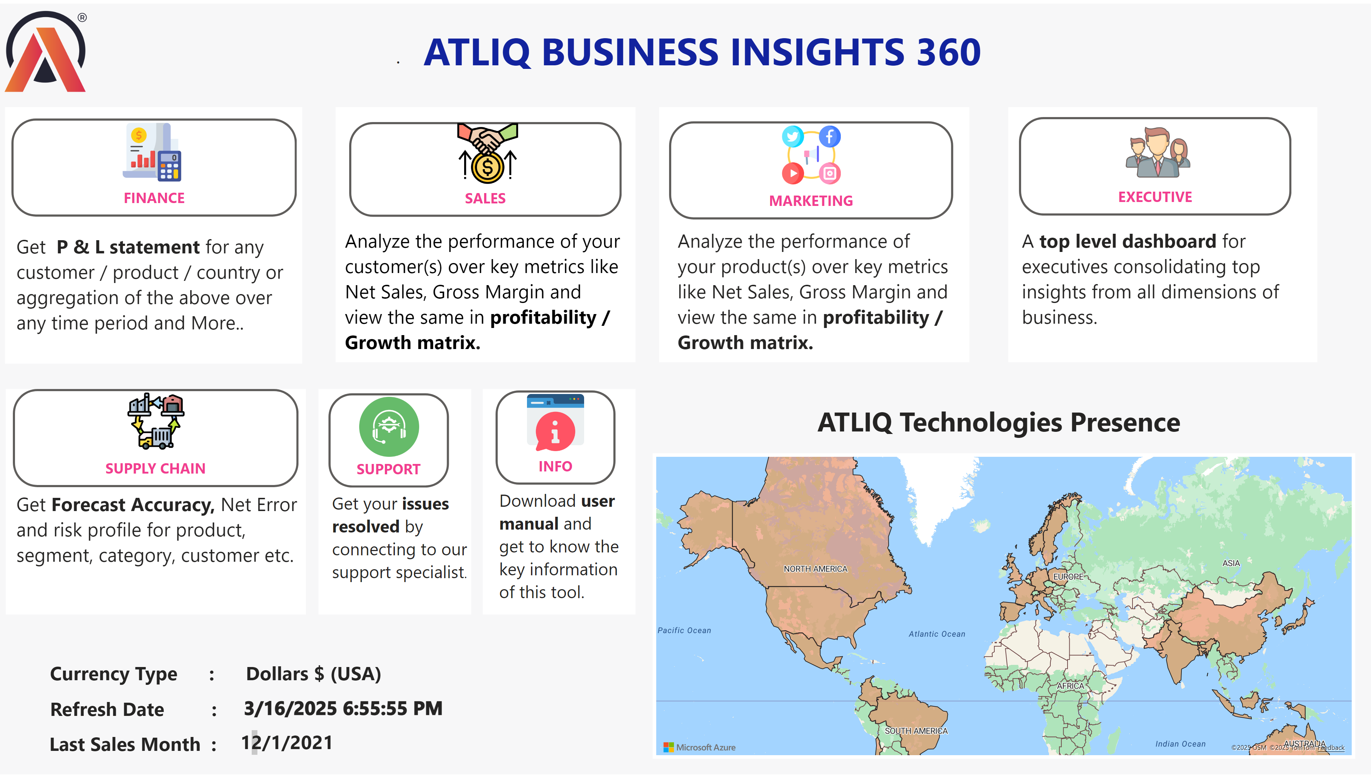
HOME
Notes:
shape
No alt text provided
shape
No alt text provided
image
No alt text provided
textbox
No alt text provided
shape
No alt text provided
image
No alt text provided
actionButton
No alt text provided
image
No alt text provided
actionButton
No alt text provided
image
No alt text provided
actionButton
No alt text provided
image
No alt text provided
actionButton
No alt text provided
textbox
No alt text provided
textbox
No alt text provided
shape
No alt text provided
textbox
No alt text provided
shape
No alt text provided
shape
No alt text provided
textbox
No alt text provided
textbox
No alt text provided
actionButton
No alt text provided
image
No alt text provided
shape
No alt text provided
textbox
No alt text provided
textbox
No alt text provided
card
No alt text provided
textbox
No alt text provided
card
No alt text provided
azureMap
No alt text provided
textbox
No alt text provided
image
No alt text provided
actionButton
No alt text provided
image
No alt text provided
actionButton
No alt text provided
textbox
No alt text provided
shape
No alt text provided
textbox
No alt text provided
shape
No alt text provided

Slide 3
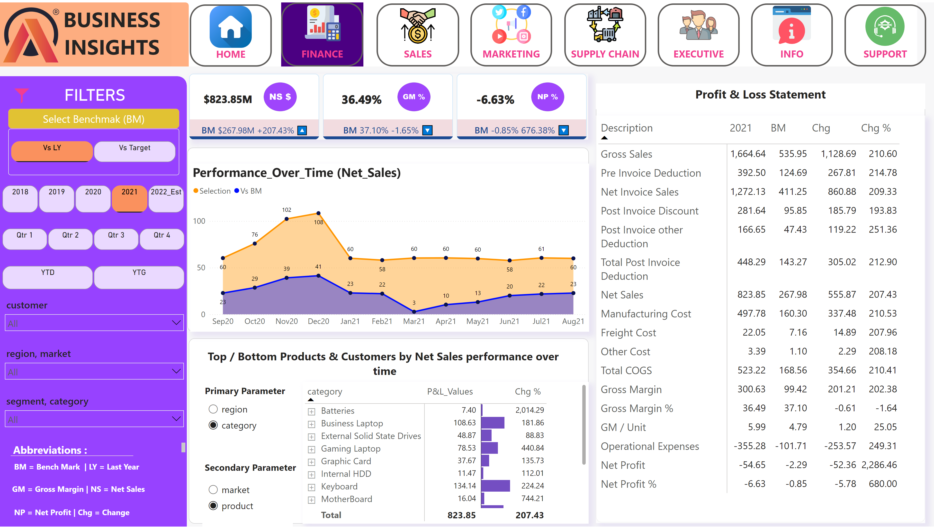
Finance_View_NEW
Notes:
advancedSlicerVisual
No alt text provided
cardVisual
No alt text provided
shape
No alt text provided
shape
No alt text provided
image
No alt text provided
textbox
No alt text provided
image
No alt text provided
textbox
No alt text provided
slicer
No alt text provided
slicer
No alt text provided
slicer
No alt text provided
shape
No alt text provided
advancedSlicerVisual
No alt text provided
advancedSlicerVisual
No alt text provided
shape
No alt text provided
advancedSlicerVisual
No alt text provided
shape
No alt text provided
textbox
No alt text provided
textbox
No alt text provided
textbox
No alt text provided
shape
No alt text provided
textbox
No alt text provided
Performance_Over_Time (Net_Sales)
No alt text provided
pivotTable
No alt text provided
card
No alt text provided
slicer
No alt text provided
textbox
No alt text provided
textbox
No alt text provided
slicer
No alt text provided
shape
No alt text provided
shape
No alt text provided
pivotTable
No alt text provided
shape
No alt text provided
textbox
No alt text provided
image
No alt text provided
actionButton
No alt text provided
image
No alt text provided
actionButton
No alt text provided
image
No alt text provided
actionButton
No alt text provided
image
No alt text provided
actionButton
No alt text provided
image
No alt text provided
actionButton
No alt text provided
image
No alt text provided
actionButton
No alt text provided
image
No alt text provided
image
No alt text provided
image
No alt text provided
actionButton
No alt text provided
card
No alt text provided
image
No alt text provided
actionButton
No alt text provided

Slide 4
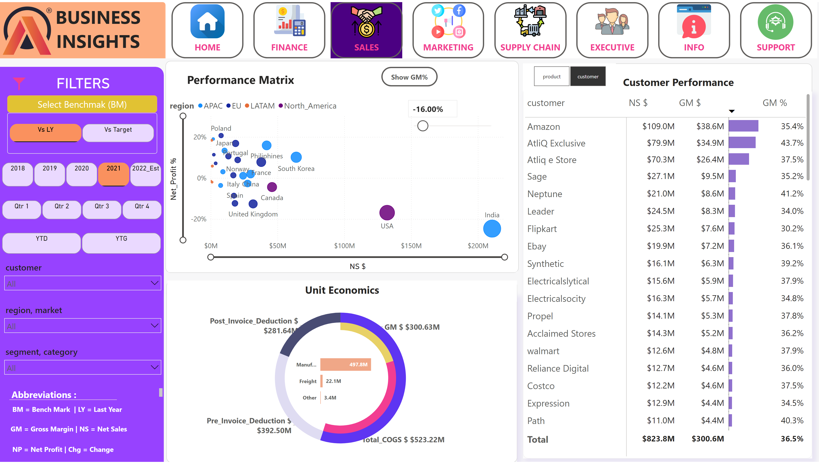
Sales_View_NEW
Notes:
advancedSlicerVisual
No alt text provided
shape
No alt text provided
shape
No alt text provided
image
No alt text provided
textbox
No alt text provided
image
No alt text provided
textbox
No alt text provided
slicer
No alt text provided
slicer
No alt text provided
slicer
No alt text provided
shape
No alt text provided
advancedSlicerVisual
No alt text provided
advancedSlicerVisual
No alt text provided
shape
No alt text provided
advancedSlicerVisual
No alt text provided
textbox
No alt text provided
textbox
No alt text provided
textbox
No alt text provided
shape
No alt text provided
textbox
No alt text provided
shape
No alt text provided
shape
No alt text provided
image
No alt text provided
actionButton
No alt text provided
image
No alt text provided
actionButton
No alt text provided
image
No alt text provided
actionButton
No alt text provided
image
No alt text provided
actionButton
No alt text provided
image
No alt text provided
actionButton
No alt text provided
image
No alt text provided
actionButton
No alt text provided
image
No alt text provided
actionButton
No alt text provided
image
No alt text provided
actionButton
No alt text provided
donutChart
No alt text provided
donutChart
No alt text provided
barChart
No alt text provided
GM% Variatoin Filter
No alt text provided
scatterChart
No alt text provided
textbox
No alt text provided
actionButton
No alt text provided
scatterChart
No alt text provided
Show GM%
No alt text provided
pivotTable
No alt text provided
textbox
No alt text provided
textbox
No alt text provided
slicer
No alt text provided
shape
No alt text provided

Slide 5
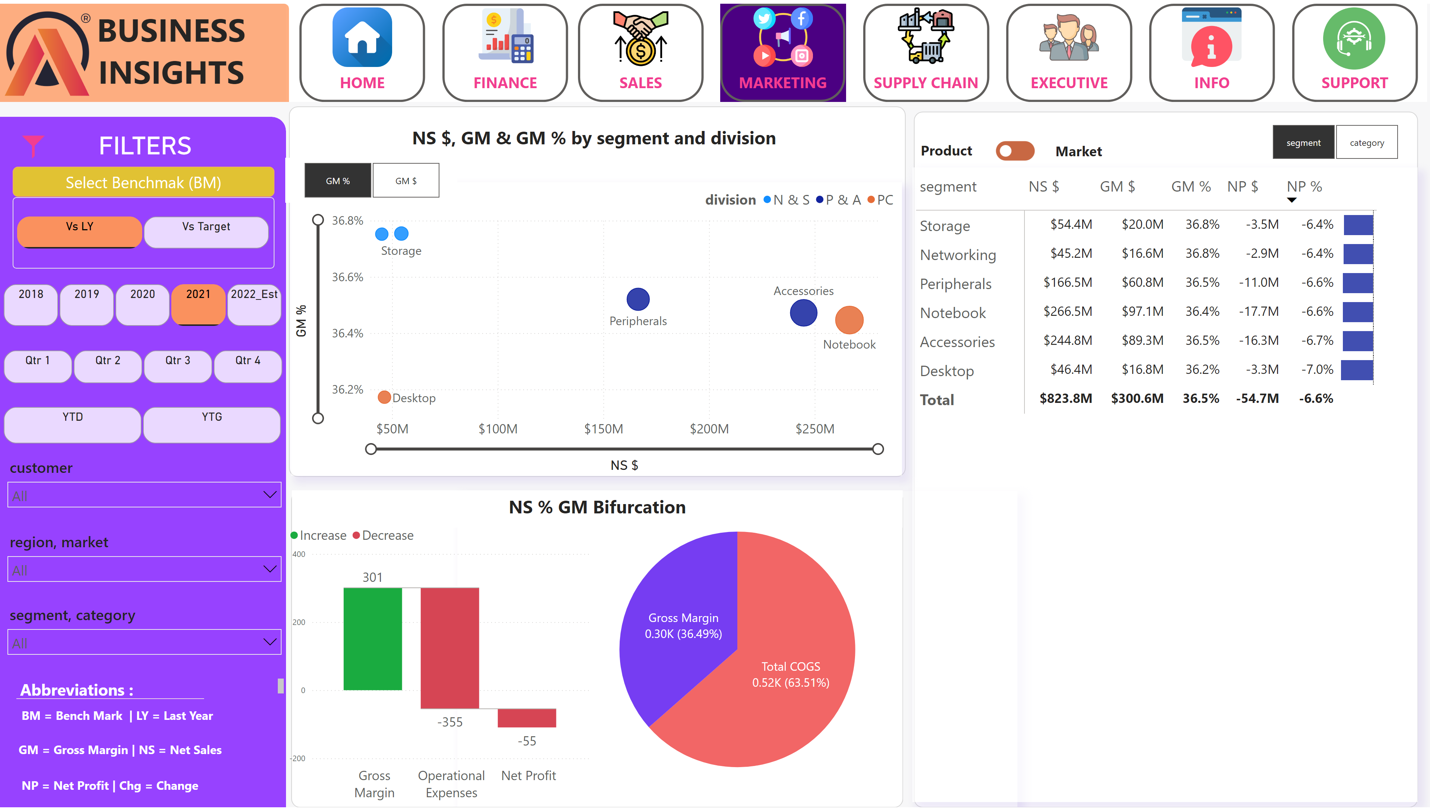
Marketing_view_New
Notes:
advancedSlicerVisual
No alt text provided
shape
No alt text provided
shape
No alt text provided
image
No alt text provided
textbox
No alt text provided
image
No alt text provided
textbox
No alt text provided
slicer
No alt text provided
slicer
No alt text provided
slicer
No alt text provided
shape
No alt text provided
advancedSlicerVisual
No alt text provided
advancedSlicerVisual
No alt text provided
shape
No alt text provided
advancedSlicerVisual
No alt text provided
textbox
No alt text provided
textbox
No alt text provided
textbox
No alt text provided
shape
No alt text provided
textbox
No alt text provided
shape
No alt text provided
shape
No alt text provided
image
No alt text provided
actionButton
No alt text provided
image
No alt text provided
actionButton
No alt text provided
image
No alt text provided
actionButton
No alt text provided
image
No alt text provided
actionButton
No alt text provided
image
No alt text provided
actionButton
No alt text provided
image
No alt text provided
actionButton
No alt text provided
image
No alt text provided
actionButton
No alt text provided
image
No alt text provided
actionButton
No alt text provided
scatterChart
No alt text provided
textbox
No alt text provided
actionButton
No alt text provided
textbox
No alt text provided
Product_Slicer
No alt text provided
slicer
No alt text provided
Produ_View_Markte_Matrix
No alt text provided
pivotTable
No alt text provided
image
No alt text provided
Toggle Product ON
No alt text provided
Product_Title
No alt text provided
Market_Title
No alt text provided
shape
No alt text provided
scatterChart
No alt text provided
slicer
No alt text provided
waterfallChart
No alt text provided
donutChart
No alt text provided

Slide 6
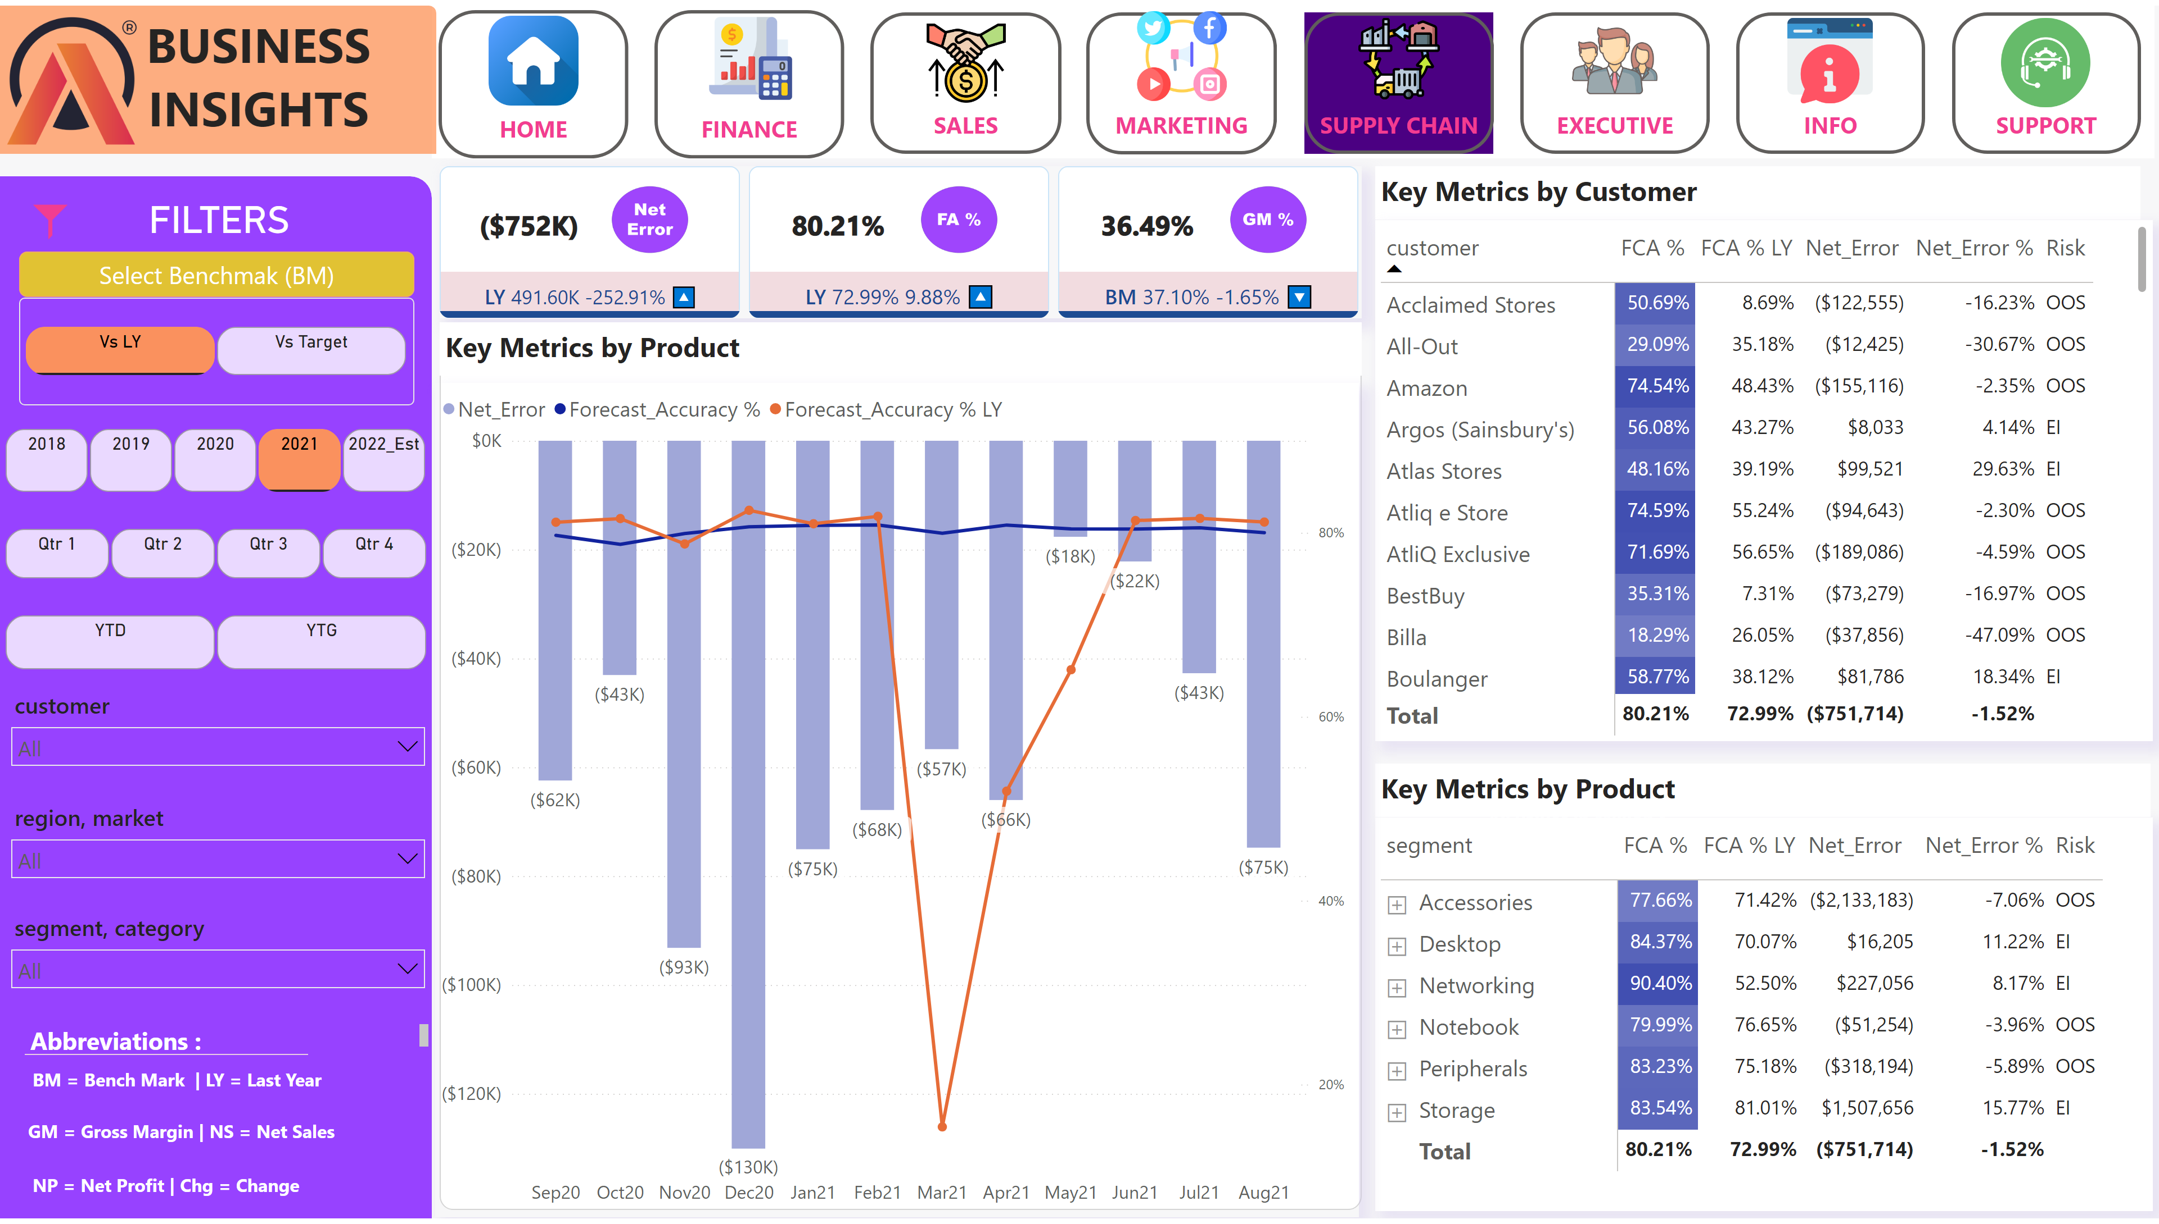
Supply_Chain_View_NEW
Notes:
advancedSlicerVisual
No alt text provided
cardVisual
No alt text provided
shape
No alt text provided
shape
No alt text provided
image
No alt text provided
textbox
No alt text provided
image
No alt text provided
textbox
No alt text provided
slicer
No alt text provided
slicer
No alt text provided
slicer
No alt text provided
shape
No alt text provided
advancedSlicerVisual
No alt text provided
advancedSlicerVisual
No alt text provided
shape
No alt text provided
advancedSlicerVisual
No alt text provided
shape
No alt text provided
textbox
No alt text provided
textbox
No alt text provided
textbox
No alt text provided
shape
No alt text provided
textbox
No alt text provided
shape
No alt text provided
textbox
No alt text provided
image
No alt text provided
actionButton
No alt text provided
image
No alt text provided
actionButton
No alt text provided
image
No alt text provided
actionButton
No alt text provided
image
No alt text provided
actionButton
No alt text provided
image
No alt text provided
actionButton
No alt text provided
image
No alt text provided
actionButton
No alt text provided
image
No alt text provided
actionButton
No alt text provided
image
No alt text provided
actionButton
No alt text provided
card
No alt text provided
Produ_View_Markte_Matrix
No alt text provided
Produ_View_Markte_Matrix
No alt text provided
textbox
No alt text provided
lineStackedColumnComboChart
No alt text provided
textbox
No alt text provided

Slide 7
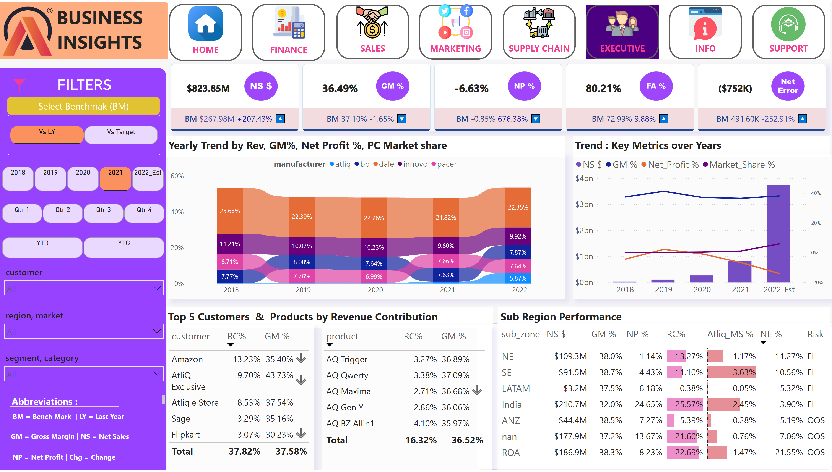
Executive_View_NEW
Notes:
advancedSlicerVisual
No alt text provided
cardVisual
No alt text provided
shape
No alt text provided
shape
No alt text provided
image
No alt text provided
textbox
No alt text provided
image
No alt text provided
textbox
No alt text provided
slicer
No alt text provided
slicer
No alt text provided
slicer
No alt text provided
shape
No alt text provided
advancedSlicerVisual
No alt text provided
advancedSlicerVisual
No alt text provided
shape
No alt text provided
advancedSlicerVisual
No alt text provided
textbox
No alt text provided
textbox
No alt text provided
textbox
No alt text provided
shape
No alt text provided
textbox
No alt text provided
shape
No alt text provided
image
No alt text provided
actionButton
No alt text provided
image
No alt text provided
actionButton
No alt text provided
image
No alt text provided
actionButton
No alt text provided
image
No alt text provided
actionButton
No alt text provided
image
No alt text provided
actionButton
No alt text provided
image
No alt text provided
actionButton
No alt text provided
image
No alt text provided
actionButton
No alt text provided
image
No alt text provided
actionButton
No alt text provided
ribbonChart
No alt text provided
textbox
No alt text provided
pivotTable
No alt text provided
textbox
No alt text provided
lineStackedColumnComboChart
No alt text provided
textbox
No alt text provided
tableEx
No alt text provided
textbox
No alt text provided
tableEx
No alt text provided

Slide 8
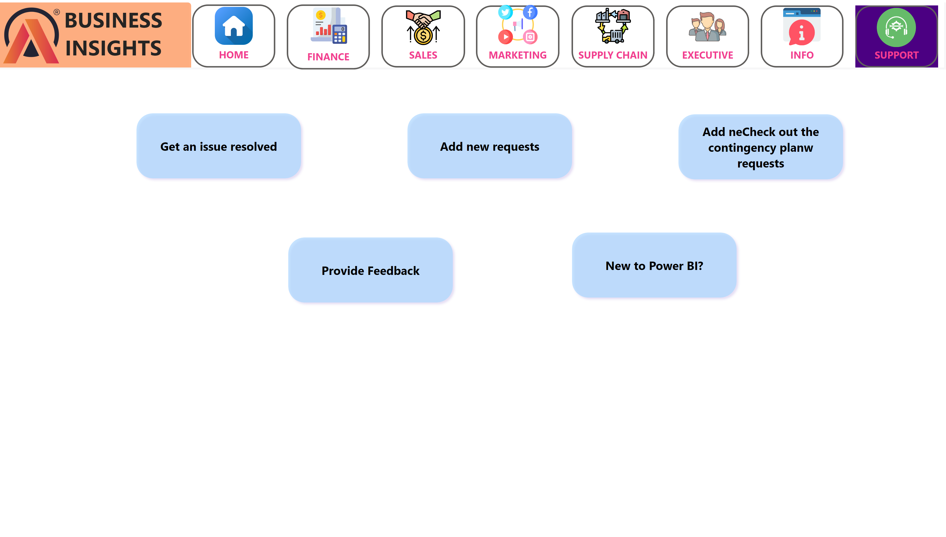
Support_Page_New
Notes:
shape
No alt text provided
shape
No alt text provided
image
No alt text provided
textbox
No alt text provided
image
No alt text provided
actionButton
No alt text provided
image
No alt text provided
actionButton
No alt text provided
image
No alt text provided
actionButton
No alt text provided
image
No alt text provided
actionButton
No alt text provided
image
No alt text provided
actionButton
No alt text provided
image
No alt text provided
actionButton
No alt text provided
image
No alt text provided
actionButton
No alt text provided
image
No alt text provided
actionButton
No alt text provided
shape
No alt text provided
shape
No alt text provided
shape
No alt text provided
shape
No alt text provided
shape
No alt text provided
shape
No alt text provided

Slide 9
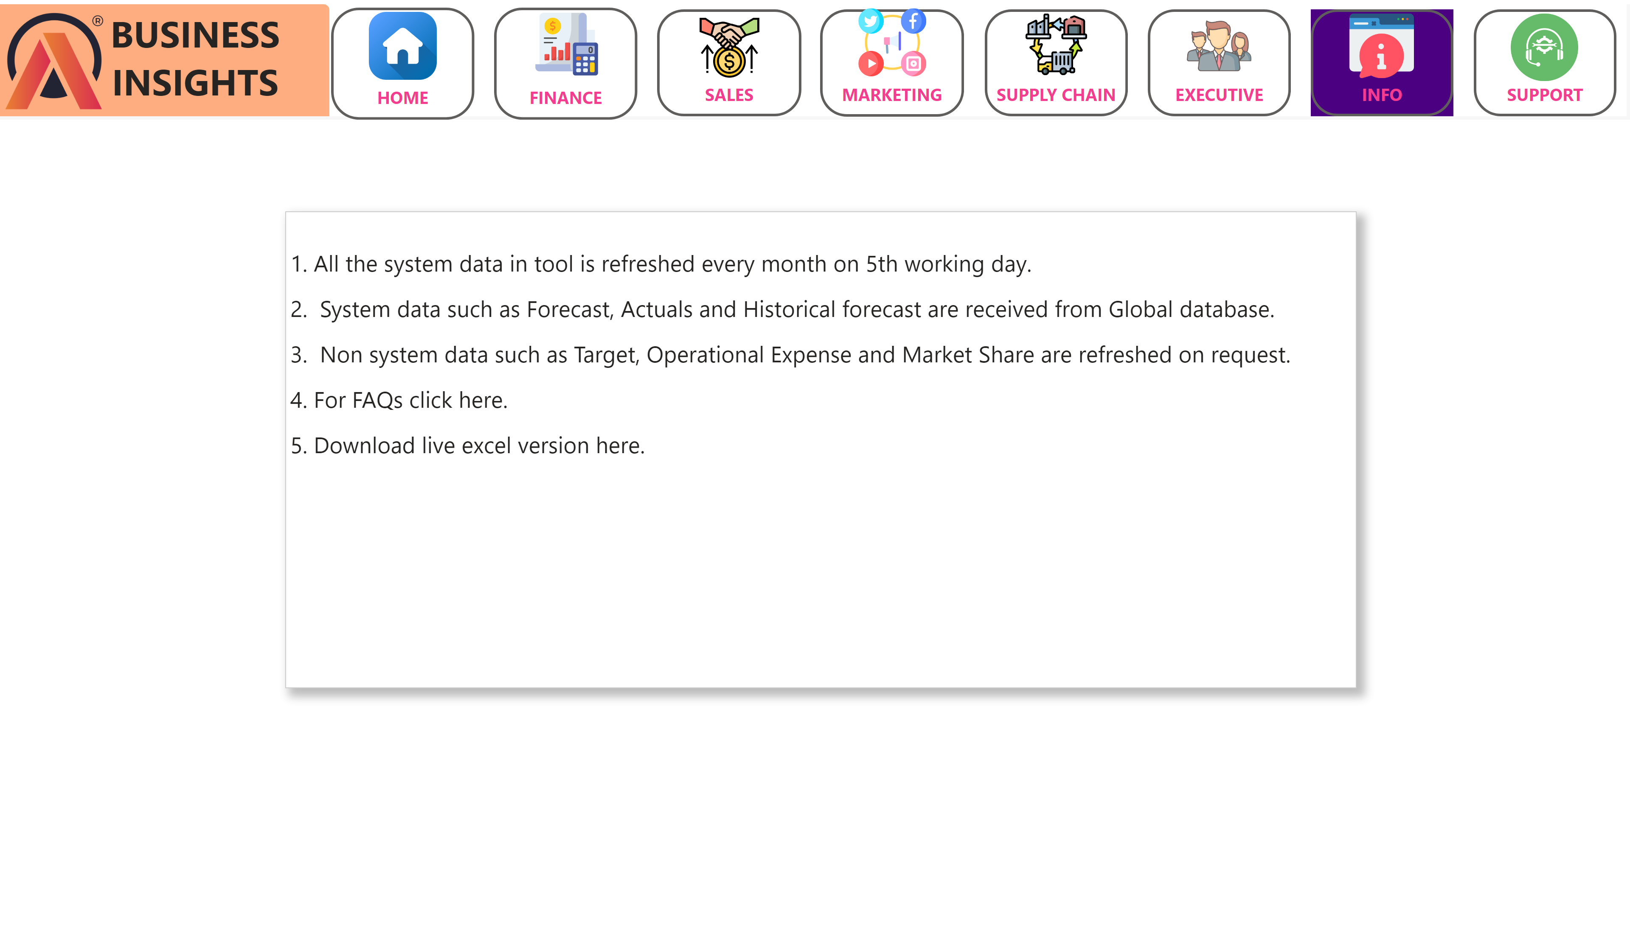
Info_Page_New
Notes:
shape
No alt text provided
shape
No alt text provided
image
No alt text provided
textbox
No alt text provided
image
No alt text provided
actionButton
No alt text provided
image
No alt text provided
actionButton
No alt text provided
image
No alt text provided
actionButton
No alt text provided
image
No alt text provided
actionButton
No alt text provided
image
No alt text provided
actionButton
No alt text provided
image
No alt text provided
actionButton
No alt text provided
image
No alt text provided
actionButton
No alt text provided
image
No alt text provided
actionButton
No alt text provided
shape
No alt text provided
textbox
No alt text provided

